Slide 1
HOUSING PROJECT
Submitted by
Khanin Deka

Slide 2
PROBLEM STATEMENT Build a machine learning model in order to predict the actual value of prospective properties and also identify the important variables affecting the price of the houses.

Slide 3
The Dataset 1) The dataset contains 1460 rows and 81 columns. 2) Out of the 81 columns, 43 are of object data- type, 35 are of integer type and 3 of float type. 3) We will use 80% of the entries to train a machine learning model.

Slide 4
DATA PREPROCESSING 1. Id column is deleted as it is nominal data to identify a housing property. 2. Utilities column is deleted as it contains only one unique value for the entire column. 3. Alley column has more than 1000 missing entries. It is assumed that these missing values signify no access to alley. 4. MasVnrType column which signifies Masonry veneer type, has some missing values. These missing values are assumed to be of type None which is one of the unique values in the column. 5. BsmtQual column which evaluates the height of the basement has missing values. These missing values are assumed to signify non-existence of basement. The missing values in BsmtCond, BsmtExposure, BsmtFinType1 and BsmtFinType2 columns are also interpreted the same way.

Slide 5
6. FireplaceQu column which signifies fireplace quality has missing entries. These missing values are assumed to signify non-existence of fireplace. 7. GarageType column has missing values. These missing values are assumed to signify non-existence of garage. The missing in columns GarageFinish, GarageQual and GarageCond are also handled the same way. 8. The missing values in PoolQC, Fence and MiscFeature are also handled the same way. 9. Encoding: Firstly the categorical columns of object data-type which give quality ratings of different infrastructure in the property are identified and for them python dictionaries are defined to map from and encode the values. For the rest of categorical columns with object data-type Label Encoder is used to encode the values. 10. Imputation: KNN Imputer is then used to impute all the missing values in the dataset. 11. Data Transformation: Power Transformer is used on continuous numeric columns with skewed data.

Slide 6
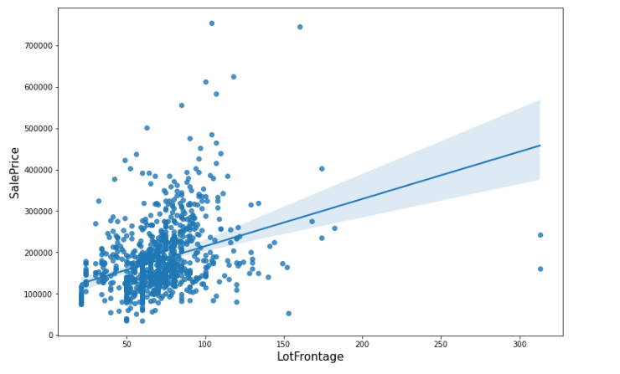
VISUALIZATION & OBSERVATIONS First lets see plots showing the relation between continuous numeric columns and sale price The slope of the regression-fit line shows positive linear relationship.

Slide 7
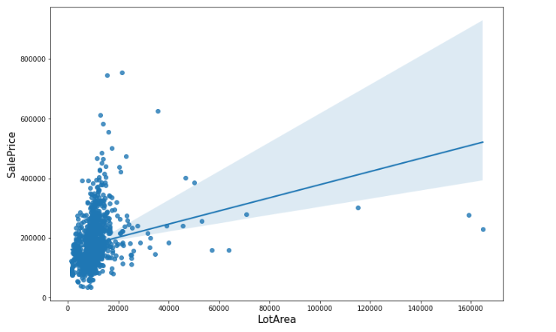
Regression plot of LotArea vs SalePrice
The slope of the regression-fit line shows positive linear relationship.

Slide 8
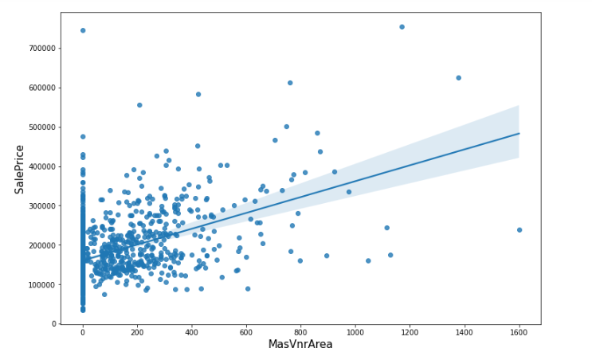
Regression plot of MasVnrArea vs SalePrice
The slope of the regression-fit line shows positive linear relationship.

Slide 9
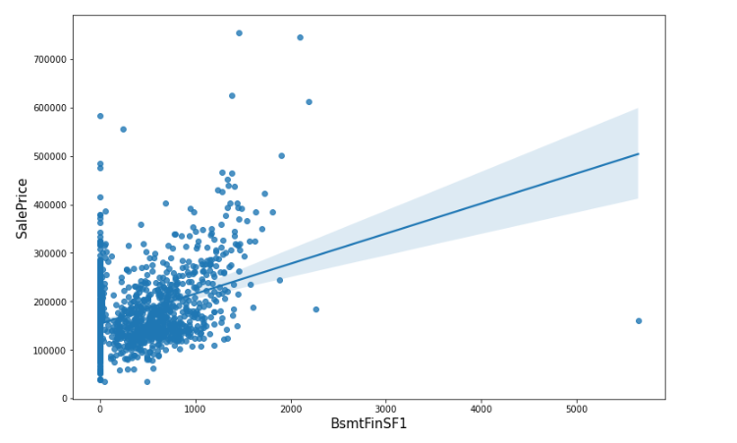
Regression plot of BsmtFinSF1 vs SalePrice
The slope of the regression-fit line shows positive linear relationship.

Slide 10
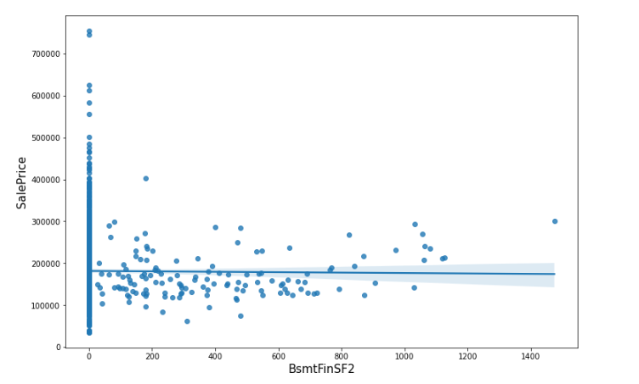
Regression plot of BsmtFinSF2 vs SalePrice
Since the regression-fit line is almost horizontal, it can be said that the relation is very weak.

Slide 11
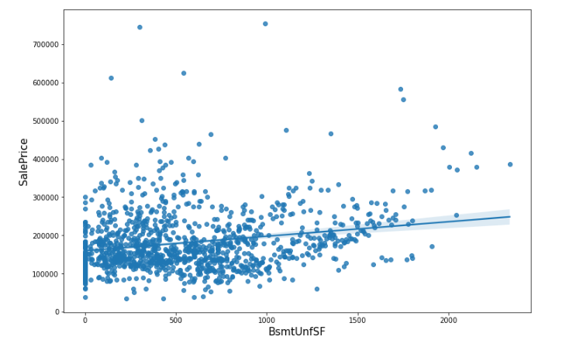
Regression plot of BsmtUnfSF vs SalePrice
The slope of the regression-fit line shows positive linear relationship. But since the slope is not very significant hence the relation is weak.

Slide 12
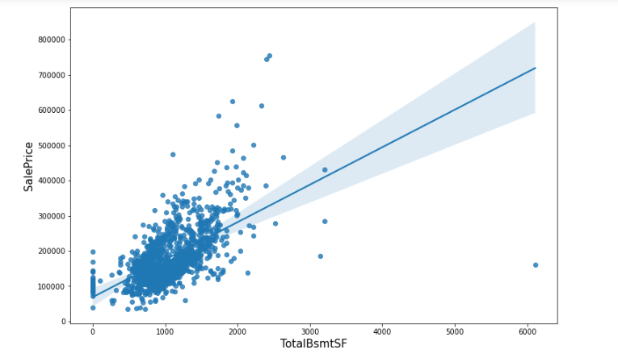
Regression plot of TotalBsmtSF vs SalePrice
The slope of the regression-fit line shows positive linear relationship.

Slide 13

Regression plot of 1stFlrSF vs SalePrice
The slope of the regression-fit line shows positive linear relationship.

Slide 14
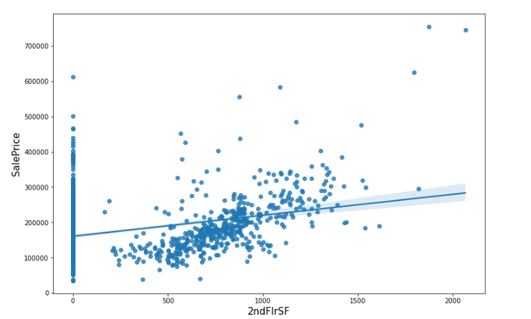
Regression plot of 2ndFlrSF vs SalePrice
The slope of the regression-fit line shows positive linear relationship but weaker compared to 1st floor surface area.

Slide 15
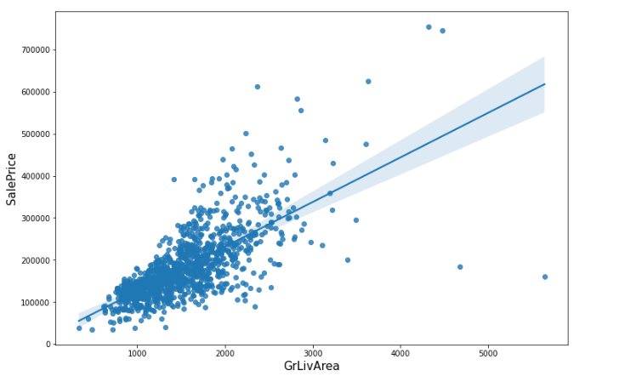
Regression plot of GrLivArea vs SalePrice
The slope of the regression-fit line shows positive linear relationship.

Slide 16
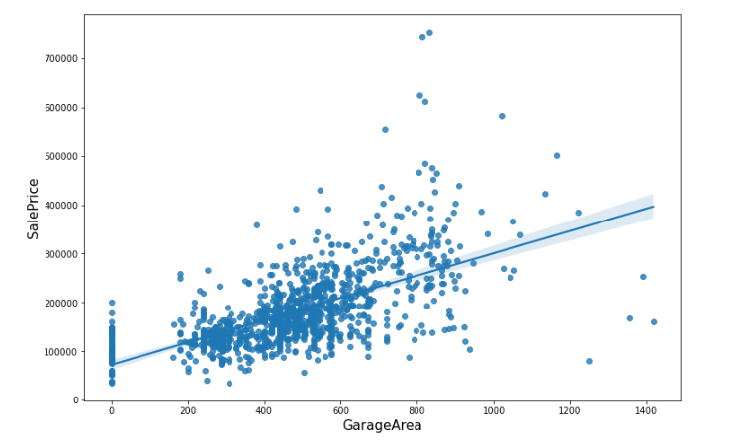
Regression plot of GarageArea vs SalePrice
The slope of the regression-fit line shows positive linear relationship.

Slide 17
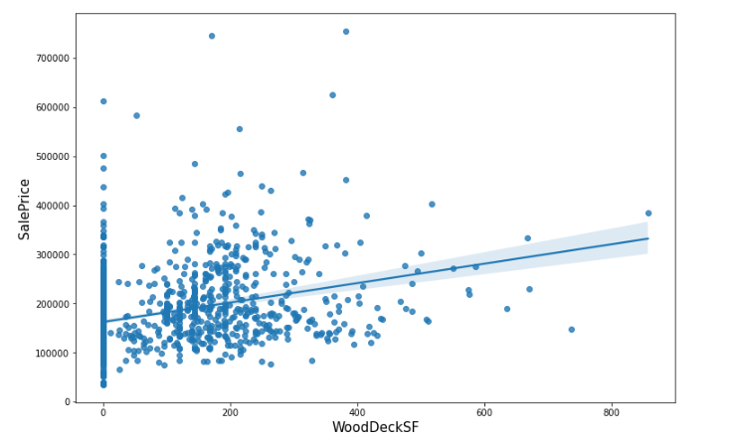
Regression plot of WoodDeckSF vs SalePrice
The slope of the regression-fit line shows positive linear relationship.

Slide 18
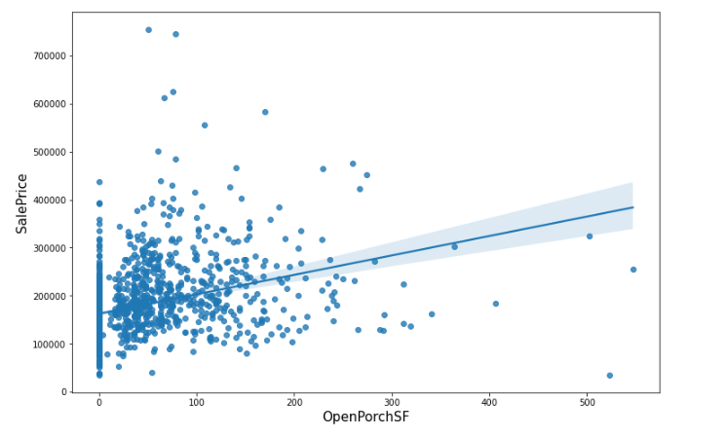
Regression plot of OpenPorchSF vs SalePrice
The slope of the regression-fit line shows positive linear relationship.

Slide 19
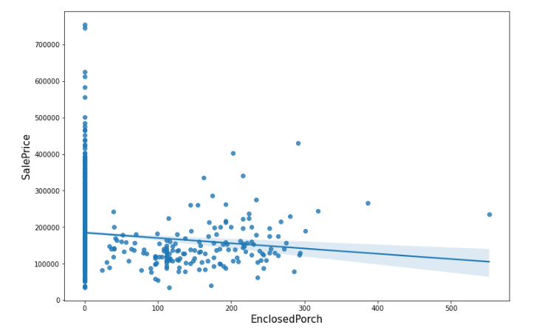
Regression plot of EnclosedPorch vs SalePrice
The slope of the regression-fit line shows a weak negative linear relationship.

Slide 20
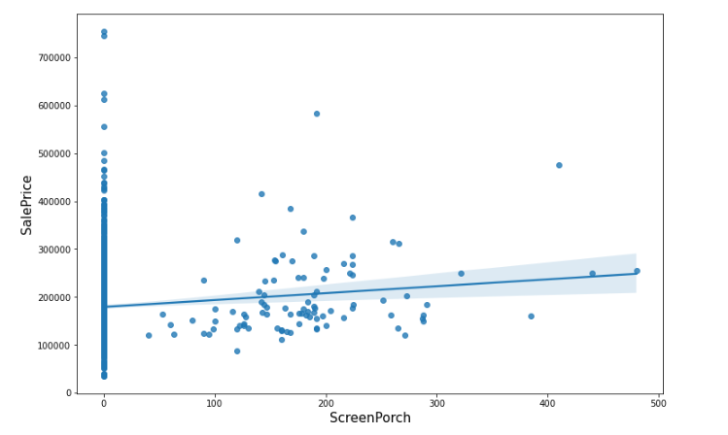
Regression plot of ScreenPorch vs SalePrice
The slope of the regression-fit line shows weak positive linear relation.

Slide 21
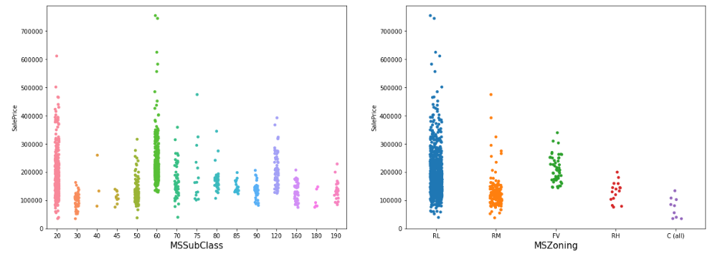
Now lets see plots showing the relation between categorical columns and sale price Observations: MSSubClass identifies the type of dwelling. Type 60(2-Storey 1946 & Newer), 75(2-1/2 Story All Ages), 80(Split Or Multi-level), 85(Split Foyer) and 120(1-Storey,PUD - 1946 & Newer) have a higher starting price then other types. Type 60 have the costliest properties. MSZoning identifies the general zoning classification of the sale. Majority of the properties belong to RL (Residential Low Density) type.

Slide 22
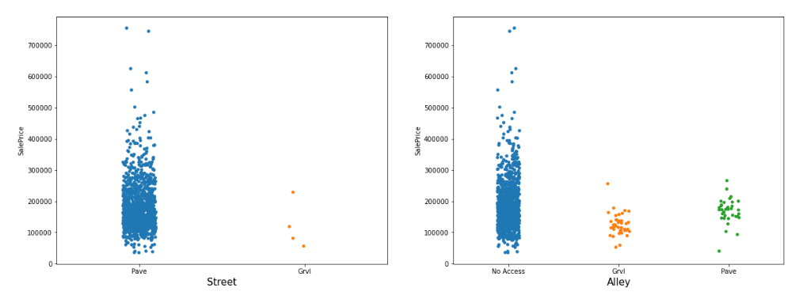
Observations:
A high majority of properties have paved street and no access to alley.

Slide 23
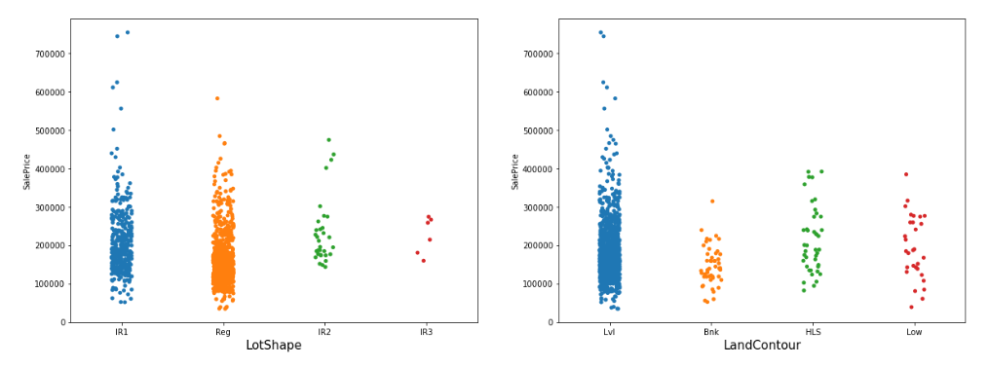
Observations:
A high majority of properties have regular or slightly irregular shape and leveled land contour.
The price of properties on unleveled land contour doesn’t go beyond 400K.
Irregular-shaped (IR3) properties doesn’t go beyond 300K.

Slide 24
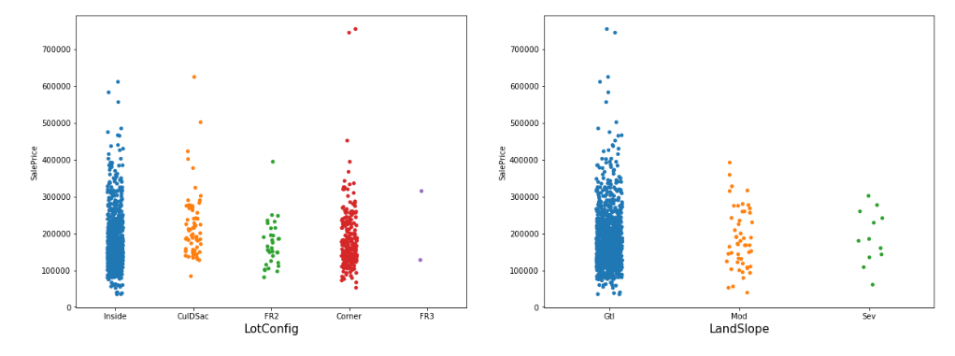
Observations:
A high majority of properties have gentle land slope.
Price of properties with moderate or severe land slope doesn’t go beyond 400K.

Slide 25
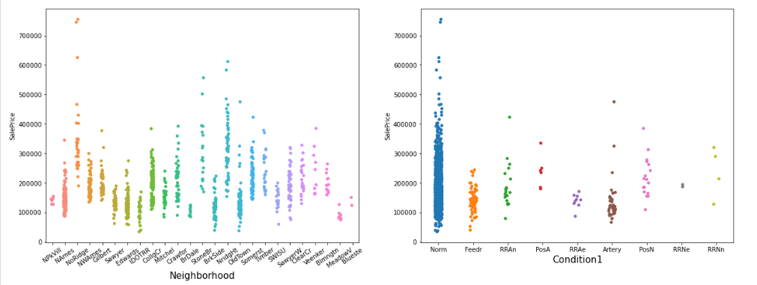
Observations:
The price range of property varies with respect to neighborhood.
In neighborhoods like NorthRidge the starting price itself is higher than the maximum price in Briardale or Meadow Village.

Slide 26
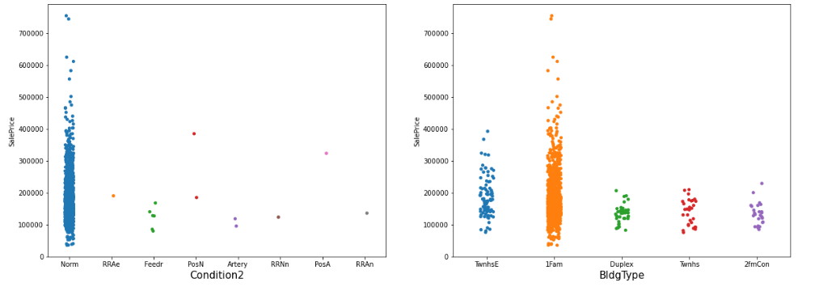
Observations:
A high majority of properties are not adjacent or in very close proximity to railroads or arterial streets.
Majority of properties are of 1Fam(single-family-detached) type.

Slide 27
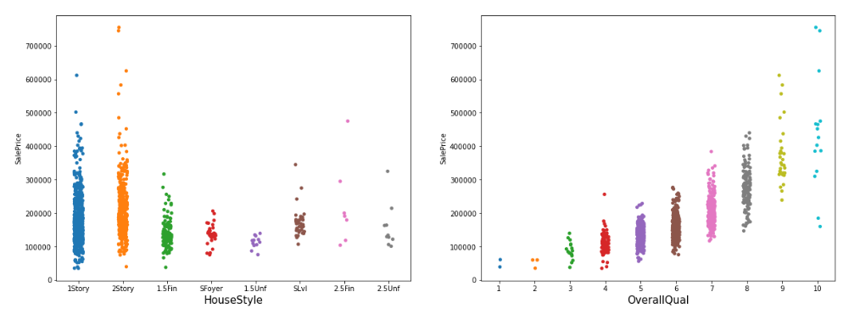
Observations:
Majority of properties are of either 1Story or 2Story type and they have a higher price range compared to others.
Better the overall quality higher is the starting price as well as maximum price.

Slide 28
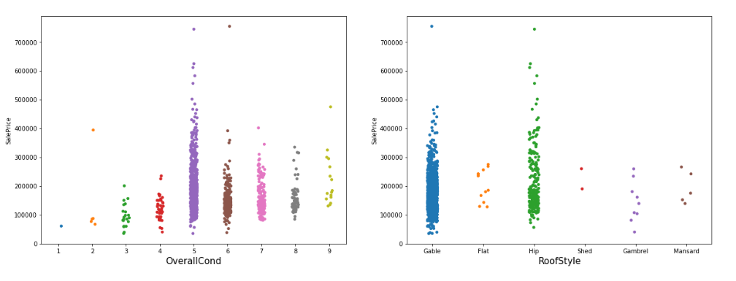
Observations:
A high majority of properties have roof style either gable or hip and they also have a much higher price range.

Slide 29
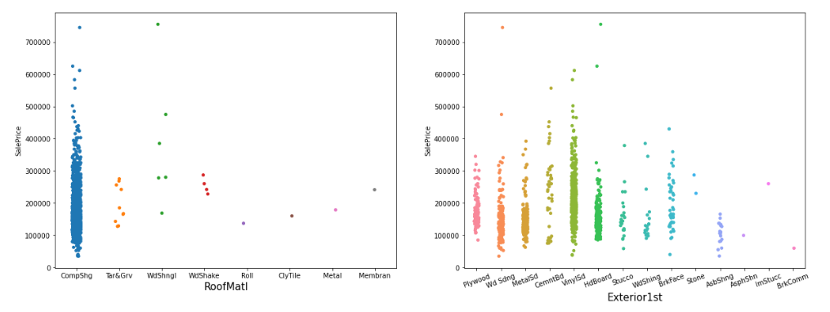
Observations:
A high majority of properties uses CompShg (Standard Composite Shingle) type of roof material.

Slide 30
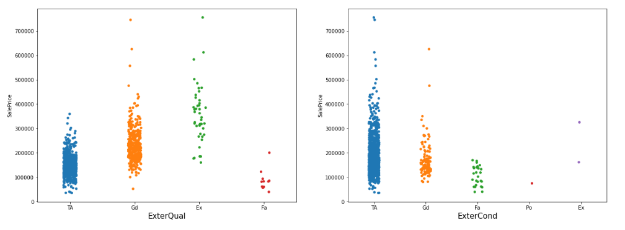
Observations:
Properties with better quality material on the exterior have higher starting price and maximum price. Those with average quality doesn’t go beyond 400K.
Out of all the properties in the dataset very few have currently excellent or poor condition of exterior materials. A high majority are in average or good condition.

Slide 31
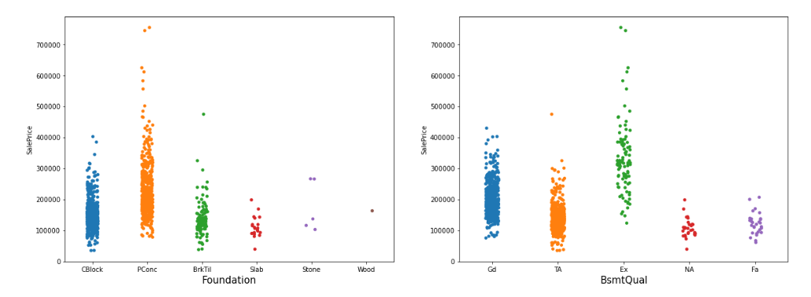
Observations:
Most of the properties have either poured concrete, or cinder block or brick-tile in their foundation. Starting price and maximum price of poured concrete type foundation is generally higher.
Properties with excellent basement have higher starting price and the maximum price goes beyond 700K. Those in good or average condition doesn’t go beyond 500K.

Slide 32
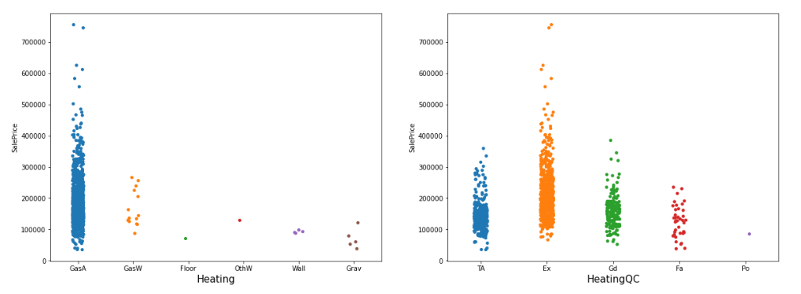
Observations:
A high majority of properties have GasA (Gas forced warm air furnace) type heating. Its price range is much higher than the other types. All the properties having price higher than 300K have this type of heating system.
Houses with better heating quality yield higher prices.

Slide 33
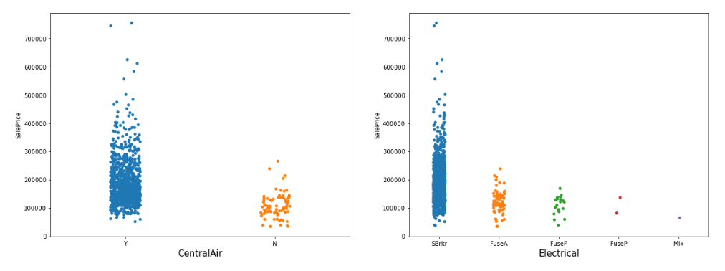
Observations:
Most of the properties have central air. Those with no central air have much lesser price and don’t go beyond 300K.
Most of the properties have SBrkr (Standard Circuit Breakers & Romex) type electrical system. All the properties of price higher than 250K have this type of electrical system.

Slide 34
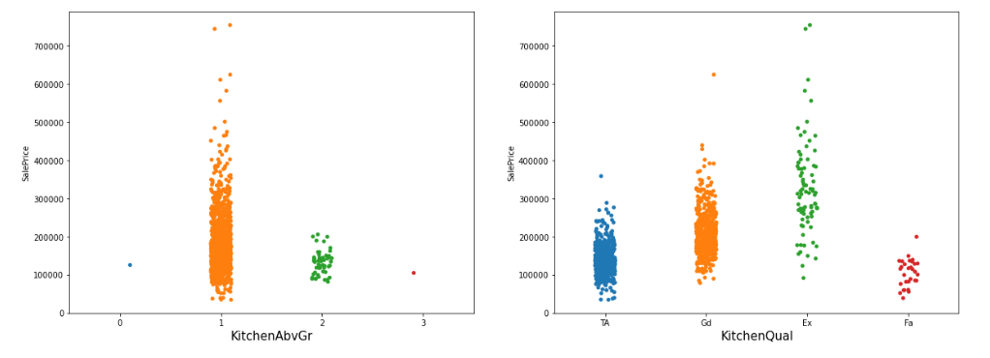
Observations:
A high majority of properties have 1 kitchen above grade.
Better the kitchen quality better is the price and range of price.

Slide 35
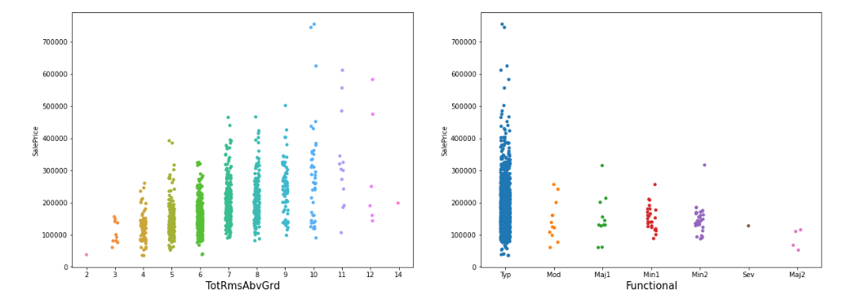
Observations:
Total rooms above grade varies from 2 to 14.
Most of the properties are of typical home functionality and no deductions are warranted. The price range is also much higher.

Slide 36
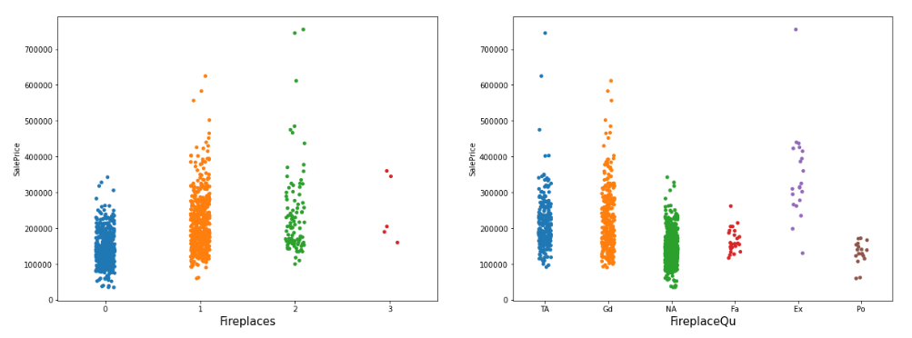
Observations:
Very few houses have more than 2 fireplaces. Having fireplace enhances the price.

Slide 37
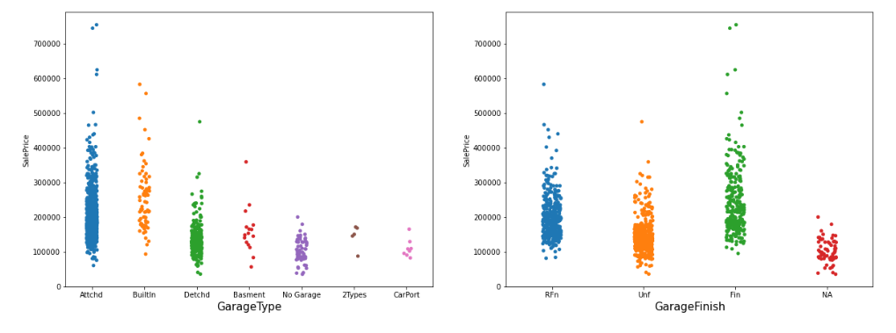
Observations:
Houses with attached or built-in garage have higher starting price. Almost all the houses beyond 350K have either attached or built-in garage.

Slide 38
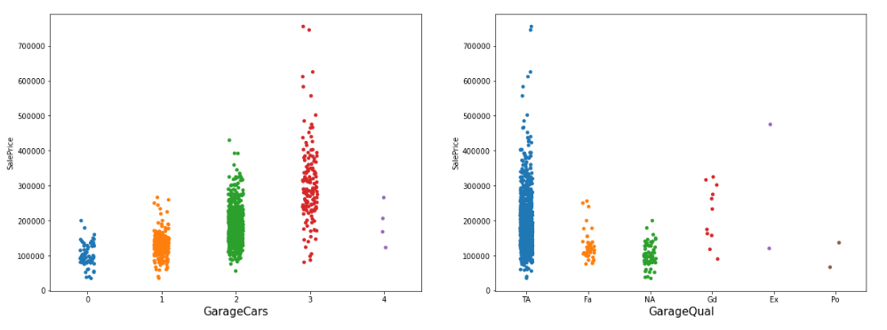
Observations:
Properties of price above 300K have space for multiple cars in the garage.
Most of the properties have the garage of average quality.

Slide 39
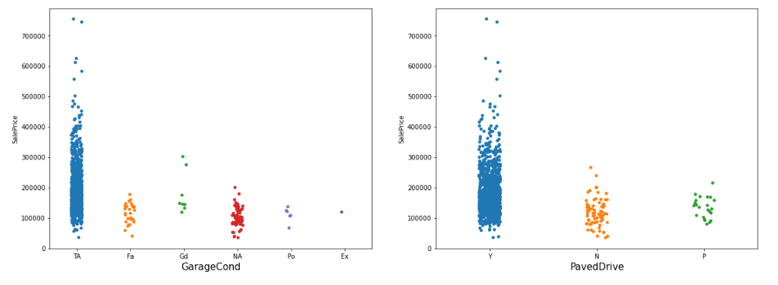
Observations:
Most of the properties have the garage in average condition.
Most of the properties have paved driveway. Those with dirt/gravel or partial pavement have lower price.
All the properties of price higher than 300K have paved driveway.

Slide 40
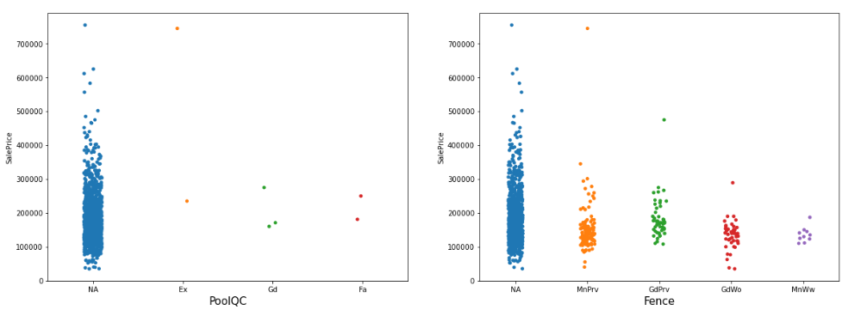
Observations:
Majority of properties doesn’t have pool and fence. However this doesn’t affect the price much as we can see numerous data points with good sale price.

Slide 41
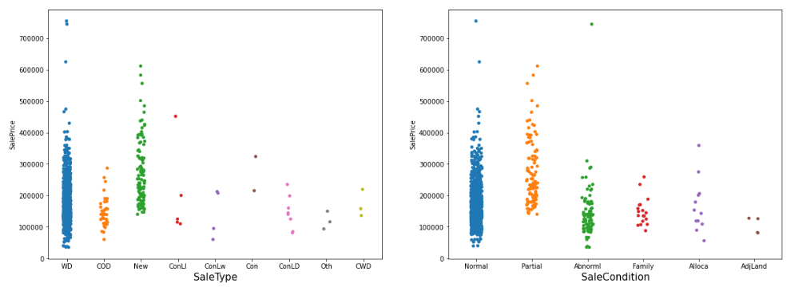
Observations:
Majority of the sale type is of WD(Warranty Deed - Conventional) or New(Home just constructed and sold). New houses have a higher starting price compared to others.
Majority of sale condition is of type Normal (Normal Sale) or Partial (Home was not completed when last assessed (associated with New Homes)). Partial type has higher starting price.

Slide 42
Performance Evaluation 1. The primary metric used for evaluation of a model is R^2 (coefficient of determination) regression score function of scikit-learn. 2. R^2 score can be interpreted as the proportion of variation in the dependent variable that is predicted by the statistical model. 3. The performance is evaluated for four different algorithms. They are: a) Linear Regression b) Random Forests Regression c) XGBoost Regression d) KNN Regression. 4. First the scores are observed for 5 different train-test splits and then the score is cross-validated for each of the models.

Slide 43
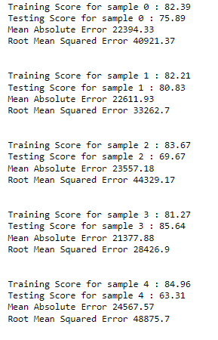
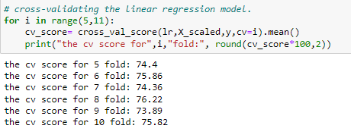
Linear Regression
Train-Test Split Results
Cross-Validation Scores

Slide 44
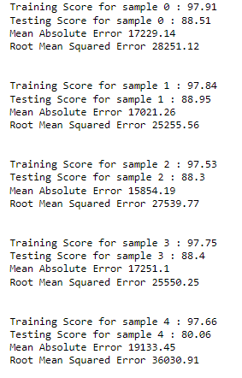
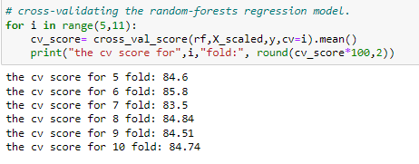
Random Forests Regression
Train-Test Split Results
Cross-Validation Scores

Slide 45
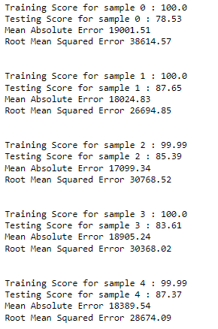
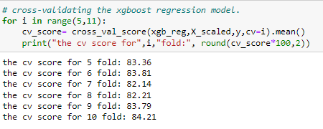
XGBoost Regression
Train-Test Split Results
Cross-Validation Scores

Slide 46
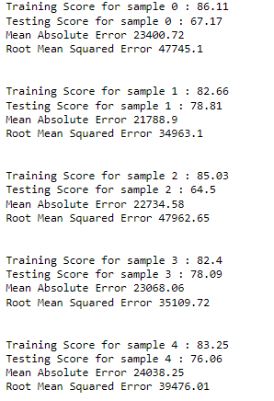
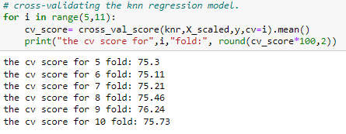
KNN Regression
Train-Test Split Results
Cross-Validation Scores

Slide 47
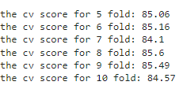
Finalized Model
Based on the results of the four models we built Random Forests is giving the best performance as it has the best R^2 score in train-test splits as well as cross-validation scores.
With the help of GridSearchCV the following parameters of Random Forests Algorithm are tuned:
No. of estimators (100)
Maximum depth of trees (15)
Minimum samples to split (3)
Cross-Validation scores of tuned model:

Slide 48
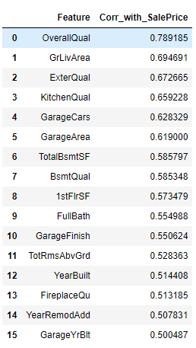
CONCLUSION Key Findings: 1. The sale price of a property depends on a lot of factors. The top 16 features affecting the sale price of a property are shown in the list along with the Pearson standard correlation coefficient. 2. Random Forests Regression Algorithm is giving the best fit results for prediction of sale price. It gives R^2 score of around 85% in cross-validation. Limitations of this work: 1. For better understanding of the housing market, model should be trained with more number of entries 2. The hyperparameters of our final model can be further tuned. 3. In this project we worked on only 4 algorithms. There are numerous other regression algorithms with which we can try to make a better model.

